Slide 1

Unit V– EMERGING DATA HANDLING TECHNIQUES
Prof.Sonali Deshpande

Slide 2
Introduction to Big data, Handling large datasets using Map-Reduce and Hadoop, Paraquet file
Format, Introduction to Hbase data model and hbase region. Introduction to emerging database technologies- Cloud Databases, Mobile Databases, SQLite Database, XML Databases,Introduction of Apache spark,Features and uses of Apache spark

Slide 3

Introduction to Big data
What is Data?
The quantities, characters, or symbols on which operations are performed by a computer, which may be stored and transmitted in the form of electrical signals.
What is Big Data?
Big Data is also data but with a huge size.
Big Data is a term used to describe a collection of data that is huge in volume and yet growing exponentially with time
In short such data is so large and complex that none of the traditional data management tools are able to store it or process it efficiently.
Examples Of Big Data
The New York Stock Exchange generates about one terabyte of new trade data per day.
The statistic shows that 500+terabytes of new data get ingested into the databases of social media site Facebook, every day.

Slide 4
Types Of Big Data
Big Data' could be found in three forms:
Structured
Unstructured
Semi-structured
Structured- Any data that can be stored, accessed and processed in the form of fixed format is termed as a 'structured' data.
An 'Employee' table in a database is an example of Structured Data
Unstructured -Any data with unknown form or the structure is classified as unstructured data.
Examples of Un-structured Data The output returned by 'Google Search'
Semi-structured- Semi-structured data can contain both the forms of data.
Examples Of Semi-structured Data Personal data stored in an XML file

Slide 5
Characteristics Of Big Data
Volume – The name Big Data itself is related to a size which is enormous. Size of data plays a very crucial role in determining value out of data.
Variety – The next aspect of Big Data is its variety. Variety refers to heterogeneous sources and the nature of data, both structured and unstructured.
Velocity – The term 'velocity' refers to the speed of generation of data. How fast the data is generated and processed to meet the demands, determines real potential in the data.

Slide 6
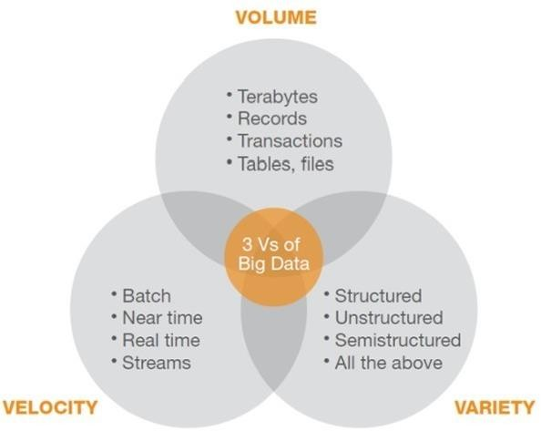

Slide 7
Map-Reduce and Hadoop
What is Hadoop?
Apache Hadoop is an open source software framework used to develop data processing applications which are executed in a distributed computing environment.
Similar to data residing in a local file system of a personal computer system, in Hadoop, data resides in a distributed file system which is called as a Hadoop Distributed File system.

Slide 8
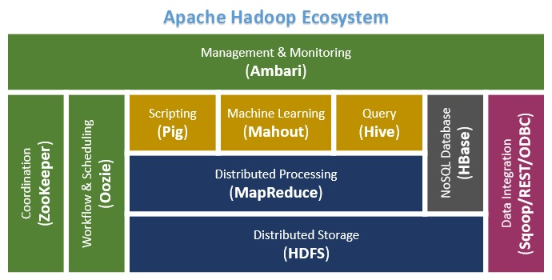
Hadoop EcoSystem and Components

Slide 9
Apache Hadoop consists of two sub-projects –
Hadoop MapReduce: MapReduce is a computational model and software framework for writing applications which are run on Hadoop. These MapReduce programs are capable of processing enormous data in parallel on large clusters of computation nodes.
HDFS (Hadoop Distributed File System): HDFS takes care of the storage part of Hadoop applications. MapReduce applications consume data from HDFS. HDFS creates multiple replicas of data blocks and distributes them on compute nodes in a cluster. This distribution enables reliable and extremely rapid computations.

Slide 10
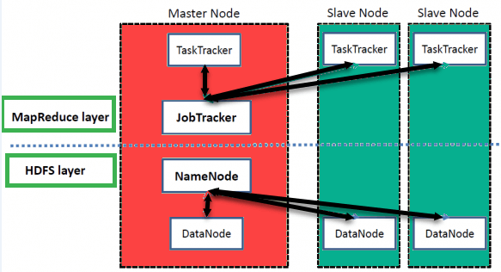
Hadoop Architecture

Slide 11
Hadoop has a Master-Slave Architecture for data storage and distributed data processing using MapReduce and HDFS methods.
NameNode: NameNode represented every files and directory which is used in the namespace
DataNode: DataNode helps you to manage the state of an HDFS node and allows you to interacts with the blocks
MasterNode: The master node allows you to conduct parallel processing of data using Hadoop MapReduce.
Slave node: The slave nodes are the additional machines in the Hadoop cluster which allows you to store data to conduct complex calculations. Moreover, all the slave node comes with Task Tracker and a DataNode. This allows you to synchronize the processes with the NameNode and Job Tracker respectively.

Slide 12
What is HDFS?
HDFS is a distributed file system for storing very large data files, running on clusters of commodity hardware. It is fault tolerant, scalable, and extremely simple to expand. Hadoop comes bundled with HDFS (Hadoop Distributed File Systems).

Slide 13
HDFS Architecture
HDFS cluster primarily consists of a NameNode that manages the file system Metadata and a DataNodes that stores the actual data.
NameNode: NameNode can be considered as a master of the system. It maintains the file system tree and the metadata for all the files and directories present in the system
DataNode: DataNodes are slaves which reside on each machine in a cluster and provide the actual storage. It is responsible for serving, read and write requests for the clients.
Read/write operations in HDFS operate at a block level. Data files in HDFS are broken into block-sized chunks, which are stored as independent units. Default block-size is 64 MB.
HDFS operates on a concept of data replication wherein multiple replicas of data blocks are created and are distributed on nodes throughout a cluster to enable high availability of data in the event of node failure.

Slide 14
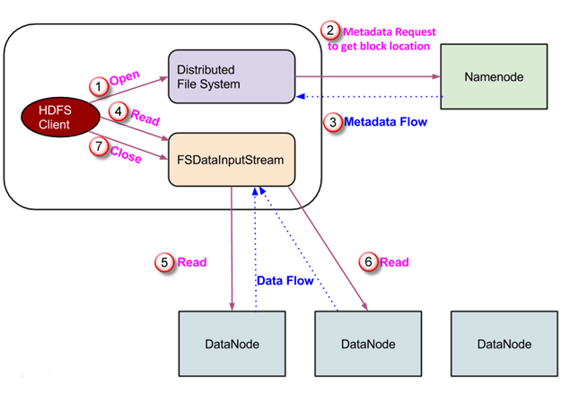
Read Operation In HDFS
Data read request is served by HDFS, NameNode, and DataNode. Let's call the reader as a 'client'. Below diagram depicts file read operation in Hadoop.

Slide 15
A client initiates read request by calling 'open()' method of FileSystem object; it is an object of type DistributedFileSystem.
This object connects to namenode using RPC and gets metadata information such as the locations of the blocks of the file. Please note that these addresses are of first few blocks of a file.
In response to this metadata request, addresses of the DataNodes having a copy of that block is returned back.
Once addresses of DataNodes are received, an object of type FSDataInputStream is returned to the client. FSDataInputStream contains DFSInputStream which takes care of interactions with DataNode and NameNode. In step 4 shown in the diagram, a client invokes 'read()' method which causes DFSInputStream to establish a connection with the first DataNode with the first block of a file.
Data is read in the form of streams wherein client invokes 'read()' method repeatedly. This process of read() operation continues till it reaches the end of block.
Once the end of a block is reached, DFSInputStream closes the connection and moves on to locate the next DataNode for the next block
Once a client has done with the reading, it calls a close() method.

Slide 16
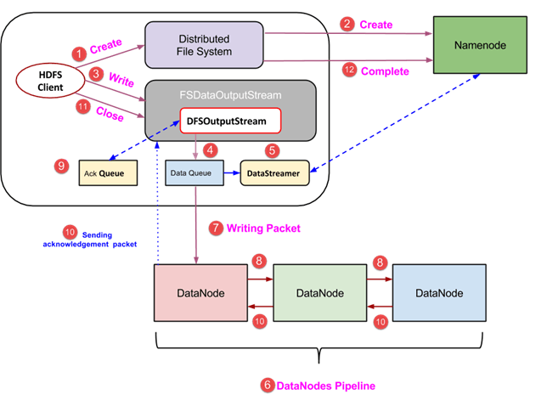
Write Operation In HDFS

Slide 17
A client initiates write operation by calling 'create()' method of DistributedFileSystem object which creates a new file - Step no. 1 in the above diagram.
DistributedFileSystem object connects to the NameNode using RPC call and initiates new file creation. If a file already exists or client does not have sufficient permission to create a new file, then IOException is thrown to the client. Otherwise, the operation succeeds and a new record for the file is created by the NameNode.
Once a new record in NameNode is created, an object of type FSDataOutputStream is returned to the client. A client uses it to write data into the HDFS. Data write method is invoked (step 3 in the diagram).
FSDataOutputStream contains DFSOutputStream object which looks after communication with DataNodes and NameNode.
There is one more component called DataStreamer which consumes this DataQueue. DataStreamer also asks NameNode for allocation of new blocks thereby picking desirable DataNodes to be used for replication.
Now, the process of replication starts by creating a pipeline using DataNodes.
The DataStreamer pours packets into the first DataNode in the pipeline.

Slide 18
Every DataNode in a pipeline stores packet received by it and forwards the same to the second DataNode in a pipeline.
Another queue, 'Ack Queue' is maintained by DFSOutputStream to store packets which are waiting for acknowledgment from DataNodes.
Once acknowledgment for a packet in the queue is received from all DataNodes in the pipeline, it is removed from the 'Ack Queue'.
After a client is done with the writing data, it calls a close() .
Once a final acknowledgment is received, NameNode is contacted to tell it that the file write operation is complete.

Slide 19
What is MapReduce?
MAPREDUCE is a software framework and programming model used for processing huge amounts of data. MapReduce program work in two phases, namely, Map and Reduce. Map tasks deal with splitting and mapping of data while Reduce tasks shuffle and reduce the data.
Hadoop is capable of running MapReduce programs written in various languages: Java, Ruby, Python, and C++.
Input Splits:
An input to a MapReduce job is divided into fixed-size pieces called input splits Input split is a chunk of the input that is consumed by a single map
Mapping
This is the very first phase in the execution of map-reduce program. In this phase data in each split is passed to a mapping function to produce output values.

Slide 20
Shuffling
This phase consumes the output of Mapping phase. Its task is to consolidate the relevant records from Mapping phase output.
Reducing
In this phase, output values from the Shuffling phase are aggregated. This phase combines values from Shuffling phase and returns a single output value. In short, this phase summarizes the complete dataset.

Slide 21
How MapReduce Organizes Work?
Hadoop divides the job into tasks. There are two types of tasks:
Map tasks (Splits & Mapping)
Reduce tasks (Shuffling, Reducing)
The complete execution process (execution of Map and Reduce tasks, both) is controlled by two types of entities called a
Jobtracker: Acts like a master (responsible for complete execution of submitted job)
Multiple Task Trackers: Acts like slaves, each of them performing the job
For every job submitted for execution in the system, there is one Jobtracker that resides on Namenode and there are multiple tasktrackers which reside on Datanode.

Slide 22
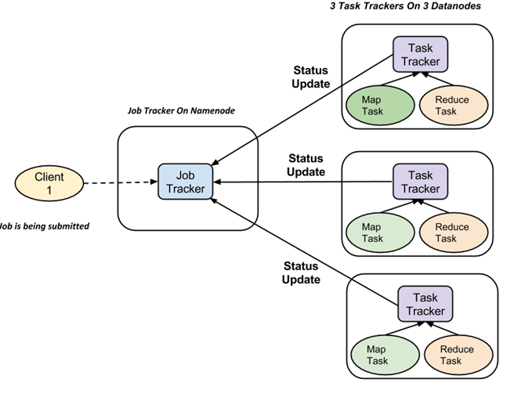

Slide 23
A job is divided into multiple tasks which are then run onto multiple data nodes in a cluster.
It is the responsibility of job tracker to coordinate the activity by scheduling tasks to run on different data nodes.
Execution of individual task is then to look after by task tracker, which resides on every data node executing part of the job.
Task tracker's responsibility is to send the progress report to the job tracker.
In addition, task tracker periodically sends 'heartbeat' signal to the Jobtracker so as to notify him of the current state of the system.
Thus job tracker keeps track of the overall progress of each job. In the event of task failure, the job tracker can reschedule it on a different task tracker.

